Slide 1
LACCF Worship Team
Public Address System Installation and Training
10/30/2022
Updated on 08/25/2023
Updated on 04/03/2024

Slide 2
Outline
Some basics of Public Address (PA) system
Our PA system
  Hardware and software
  User’s manual

Slide 3
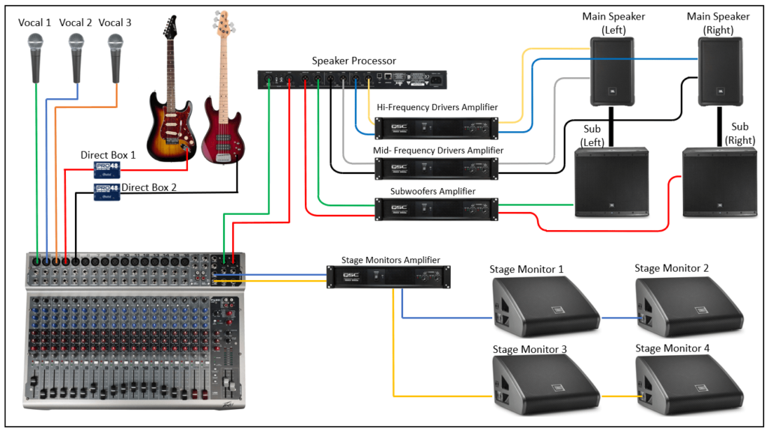
Public Address (PA) System
Outputs
Inputs
Mixer

Slide 4
A Glimpse of Our PA System
Mixer
  Behringer X32 rack (22 IN, 14 OUT)
  DELL PC for control and audio interfaces
Inputs:
  2 wired microphones (SM58)
  GTD G-787 wireless microphone receiver
    wireless bodypack x2
    wireless handhold x2
  2 keyboards
  HDMI audio input through AUX ports
  PC audio through X32 audio interface (X-USB)
  1 guitar (with built-in pickup)
  1 violin (needs pickup)
Auxiliaries
  Power conditioner
  Power extension cord and outlets
  Digital Stage box Behringer SD16, 16 Input, 8 Output
  Snake cable, 8 sends, 4 returns
  DI boxes (for active/powered inputs)
Outputs
  Main output
    Speaker power amplifier (Behringer NX3000)
    Two wall-mounted speakers (Left & Right)
  Monitors
    Headamp-powered in-ear monitors for singers 1
    Battery-powered in-ear monitors for singers 2
    Headamp-powered in-ear monitors for pianists 1
    Battery-powered in-ear monitors for pianists 2
  Other outputs
    Digital audio for live streaming
    FM radio for the next-door
    Headphone at the console (for monitoring)

Slide 5
PA System – Signal Flow
Wall-mount
Dell desktop PC
Behringer X32 rack – digital mixer
(with built-in audio interface)
Loudspeakers
Ethernet cable for control console
USB cable for audio interface
Aux In
Main LR
NX3000 Amplifier
HDMI cable
Aux Out
USB cable
Audio extracted
3.5 mm to RCA
Aux Out
HDMI Switch/Splitter
Front stage – left side
GTD Audio G-787 wireless mic
(bodypacks and handhelds)
Behringer SD16
16 in x 8 out
Headamp >> In-ear monitors
Sound Blaster K3+
Audio interface
Active in-ear monitor
Microphones (SM58), Keyboards, Guitar
FM transmitter
Front stage – right side
Active in-ear monitor
Stage snake
Other instruments
Headamp >> In-ear monitors

Slide 6
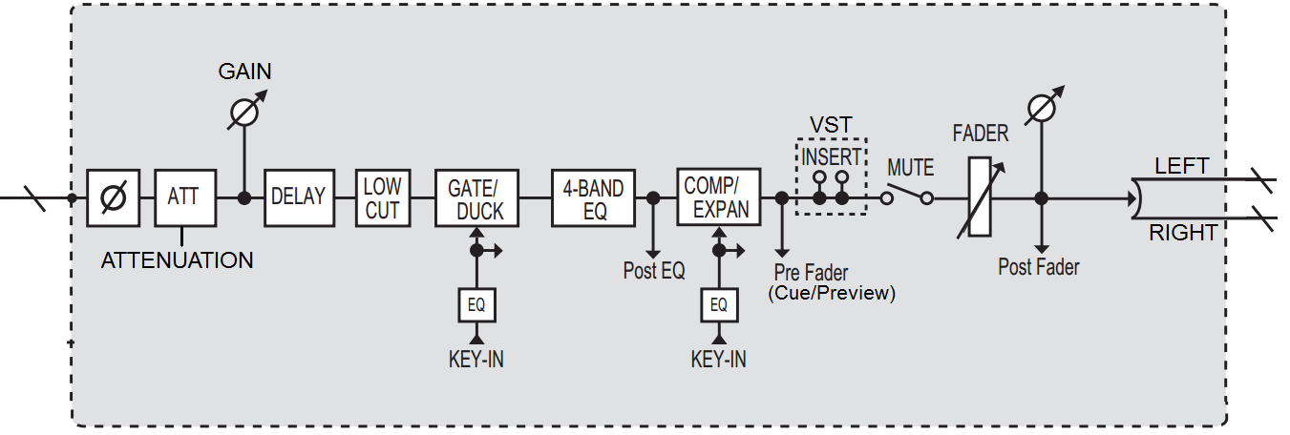
Signal Flow inside a mixer

Slide 7
Signal Levels: mic/line/speaker
Typical voltage
Mic: 0.001 – 0.1
Line: 0.1 – 10.0
Speaker: 10 - 100

Slide 8
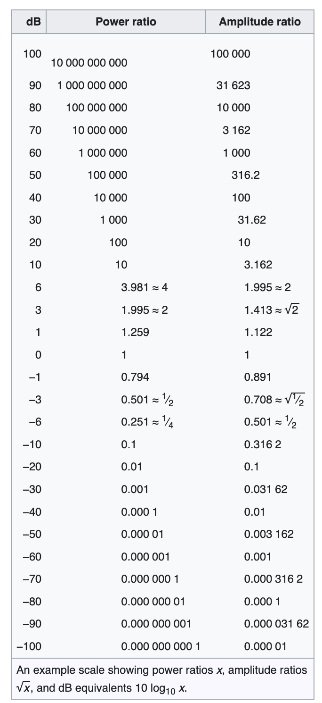
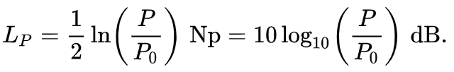

Decibel

Slide 9
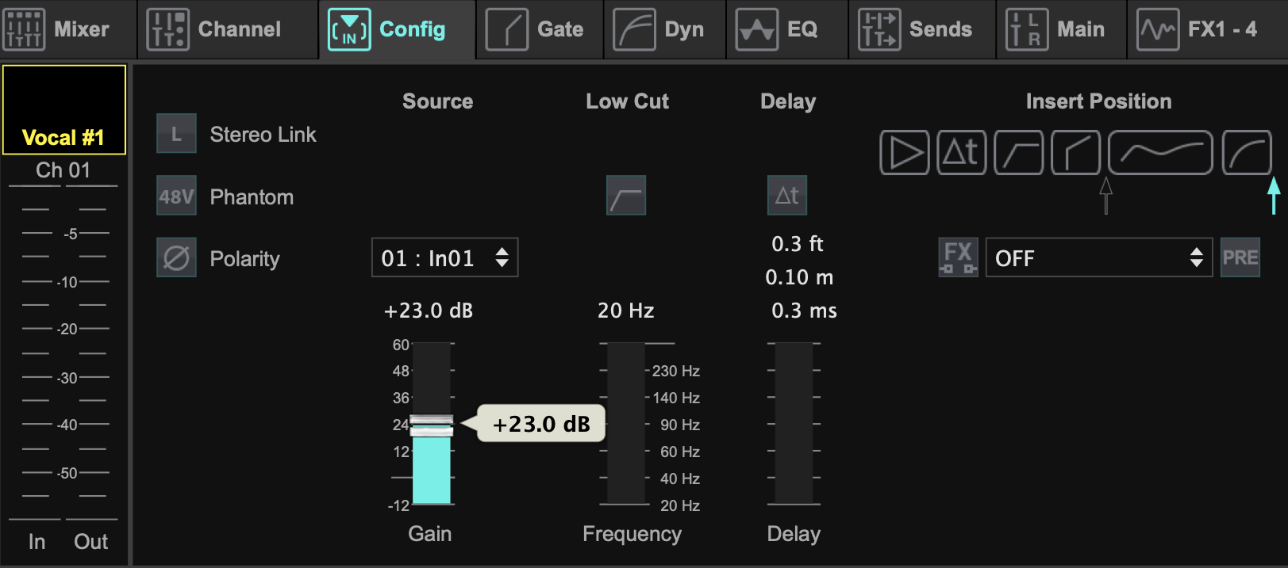
Gain: the most important parameter
Avoid too small, for the sake of good signal/noise ratio and good dynamical range
Avoid too large, otherwise feedback, or even sound will be clipped and/or distorted

Slide 10
Impedance
SM58 microphone: 150 Ohm
Guitar pickup: easily beyond 10000 Ohm

Slide 11
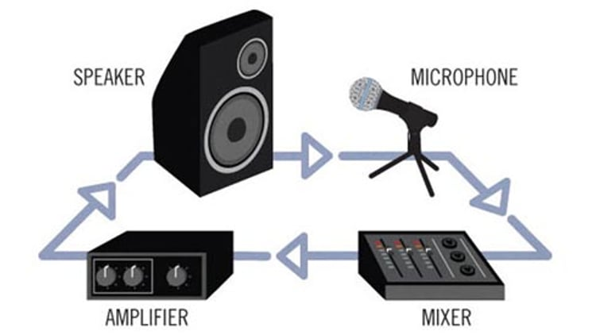
Feedback Loop

Slide 12
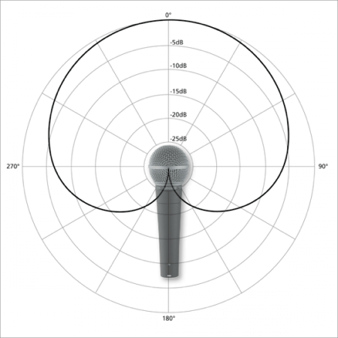
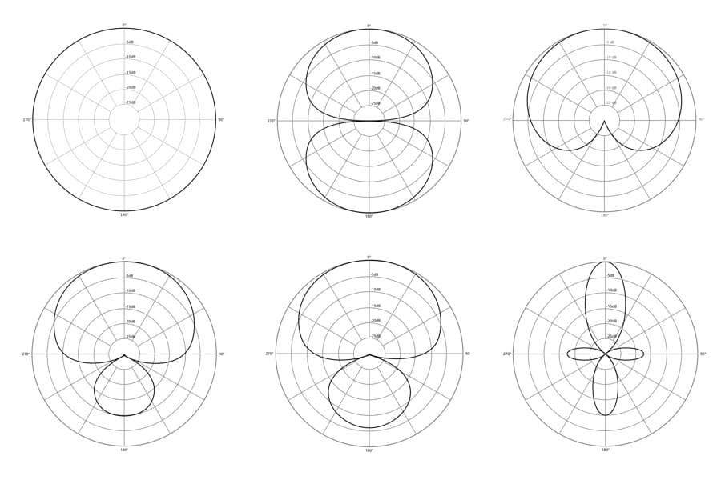
Microphone Pattern

Slide 13
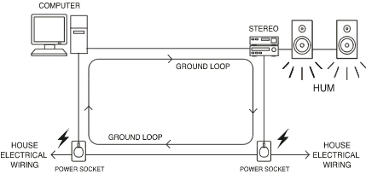
Ground Loop

Slide 14
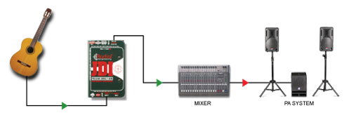
DI Box: a solution of impedance matching and ground loop

Slide 15
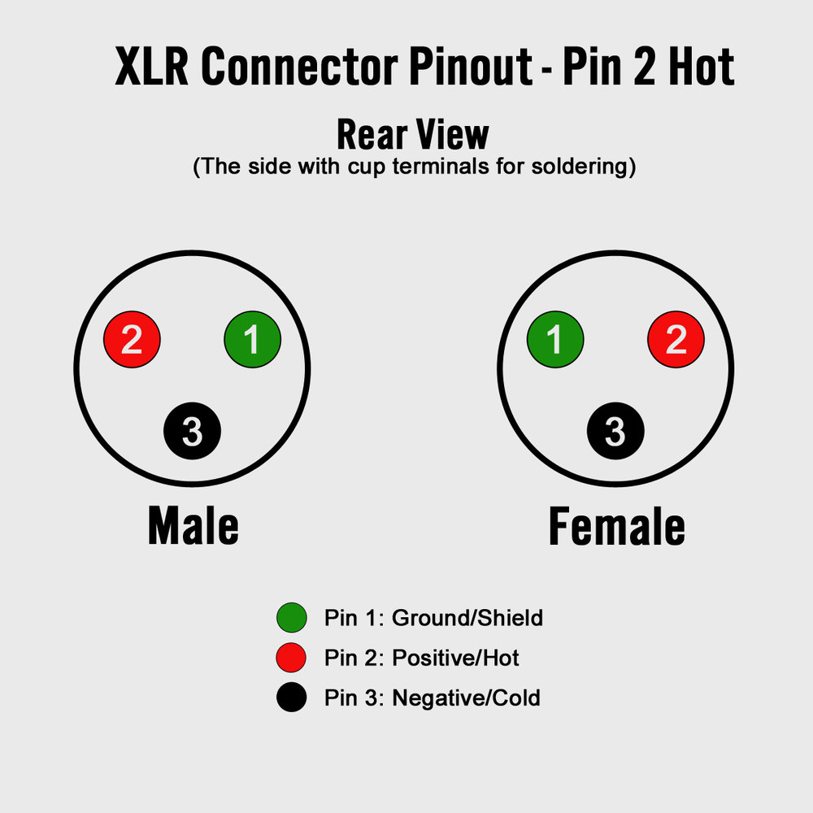
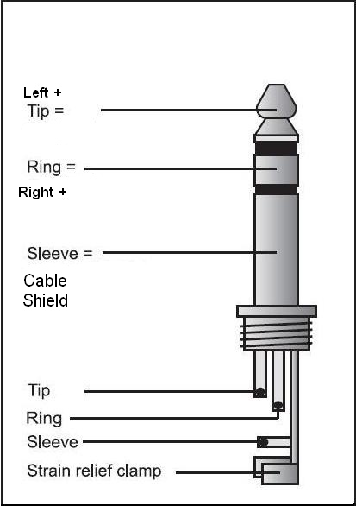
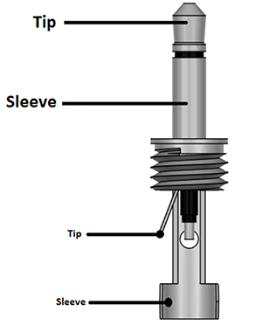
Cables: XLR/TRS/TS
Balanced
Balanced
unbalanced

Slide 16
Balanced Noise Cancellation

Slide 17
MixBus

Slide 18
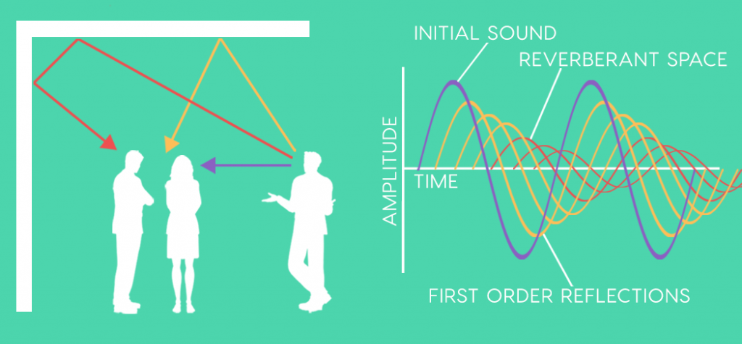
Reverb

Slide 19
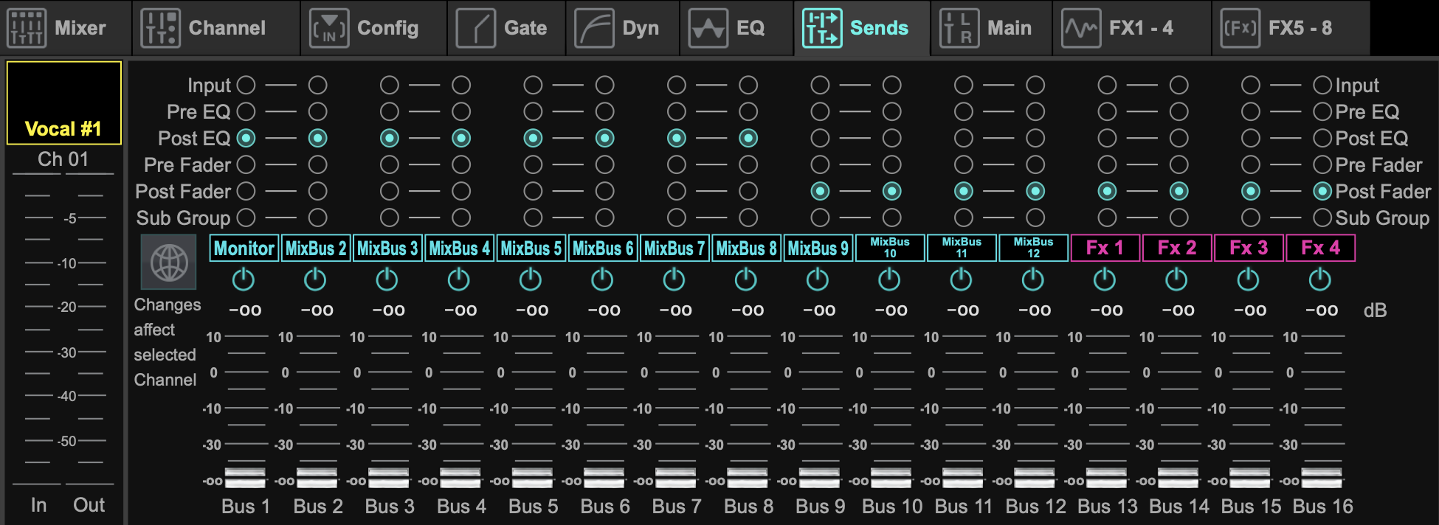
Fx (effect, e.g., reverb) Send/Return

Slide 20
EQ/Comp/Gate ….

Slide 21
Our PA System: Hardware and Software
Mixer
  Behringer X32 rack (22 IN, 14 OUT)
  Laptops for control and audio interfaces
Inputs:
  4 wired microphones
  4 wireless microphones
  2 keyboards
  Line-in from the Preach computer
  USB input from the console
  1 guitar (with built-in pickup)
  1 violin (needs pickup)
Auxiliaries
  Power conditioner, Furman M-8x2 8 outlets
  Power extension cord and outlets
  Digital Stage box Behringer SD16, 16 Input, 8 Output
  Snake cable, 8 sends, 4 returns
  DI boxes (for active/powered inputs)
Outputs
  Main output
    Speaker power amplifier (Behringer NX3000)
    Two wall-mounted speakers (Left & Right)
  Monitors
    Headamp x 2 (1 in 4 out)
    Battery-powered in-ear monitors x2
  Other outputs
    Digital audio for live streaming
    FM radiofor the next-door
    Headphone at the console (for monitoring)

Slide 22
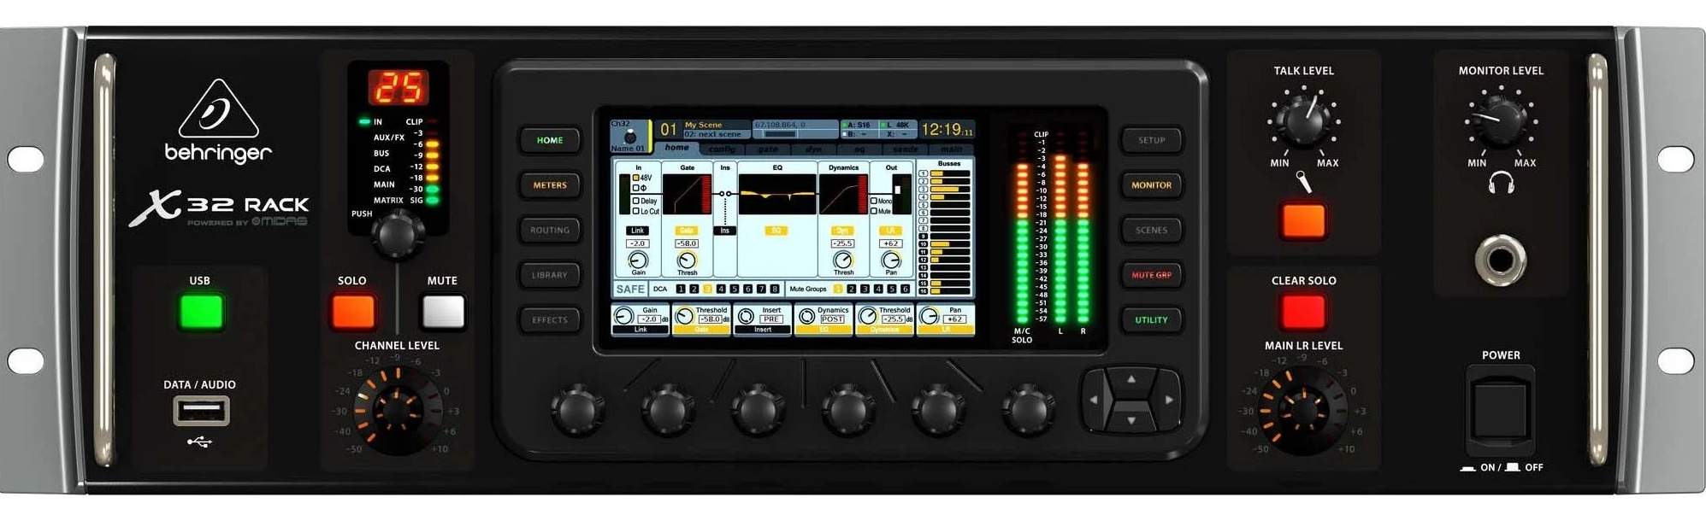
Digital Mixer: Behringer X32 Rack
The heart of our PA system

Slide 23
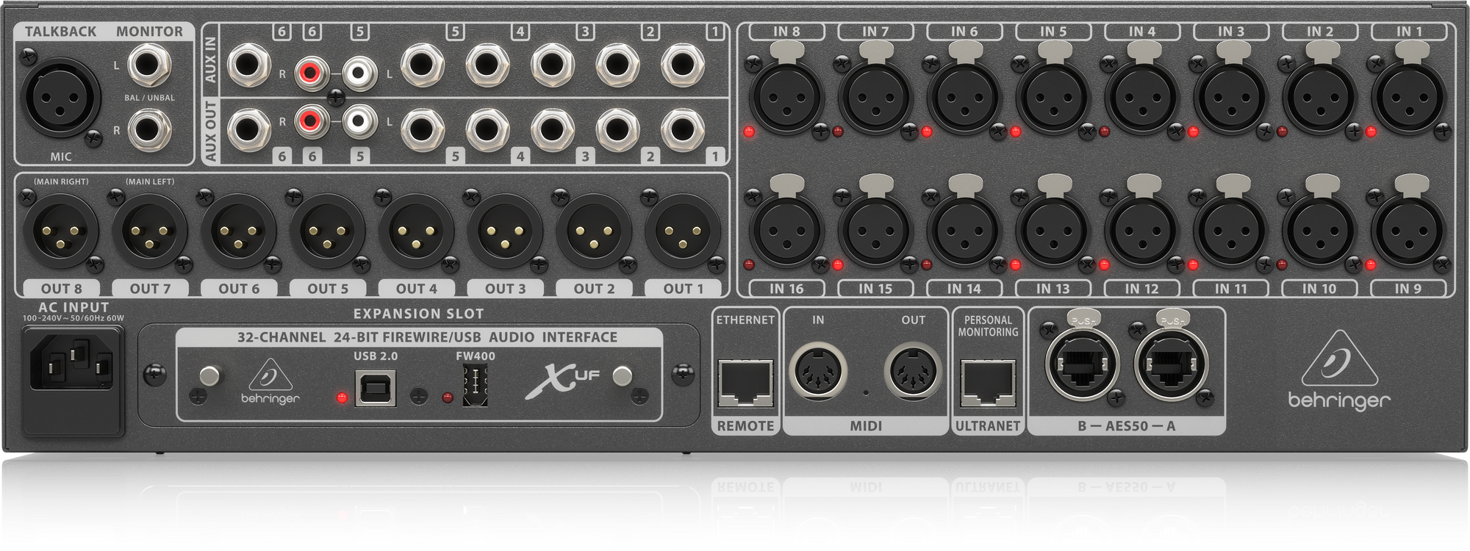
X32 Rack Built-in Audio Interface (i.e., the “card”) we use it for streaming and multimedia playback

Slide 24
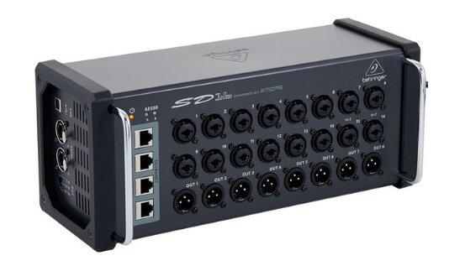
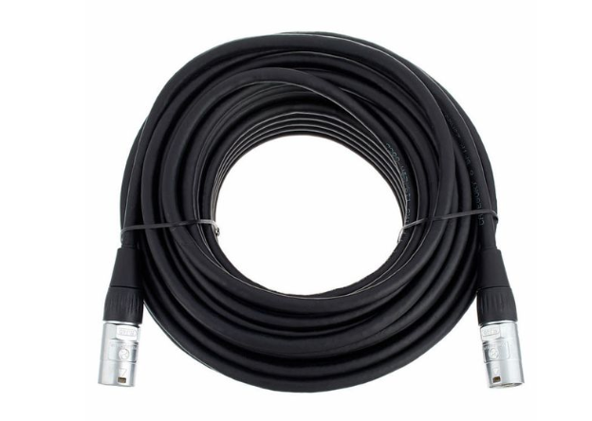
Digital Stage Boxes
Behringer SD16
pro snake CAT6E Cable

Slide 25
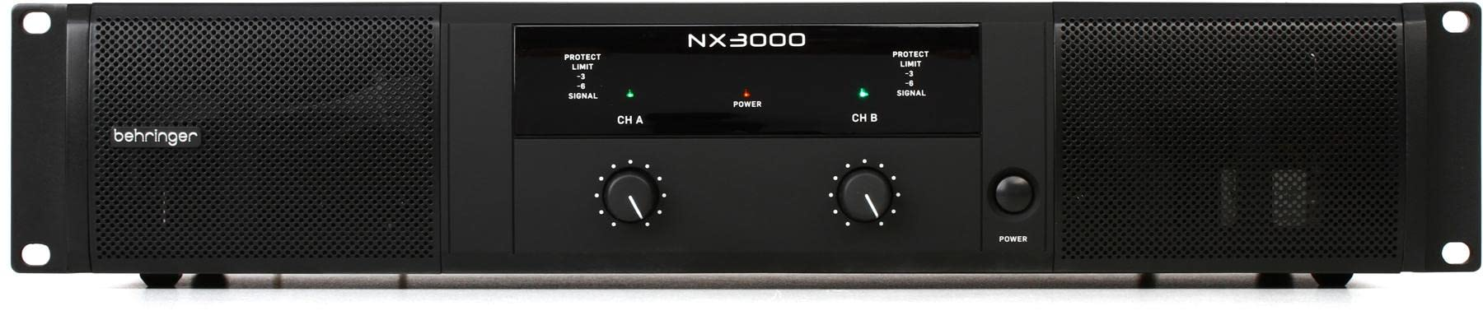
Power Amplifier: Behringer NX3000
Please keep the settings unchanged (tuned once, and for all)

Slide 26
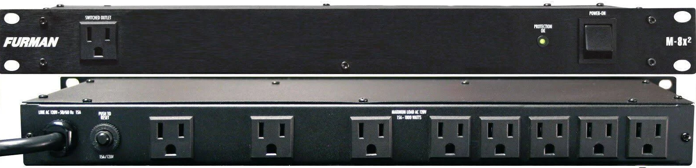
Power Conditioner: Furman M-8x2
For cleaner power supply

Slide 27
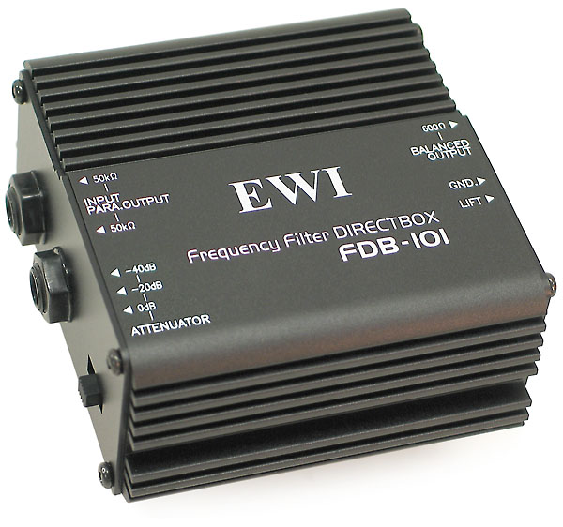
DI Box: EWI FDB-101
Passive DirectBox for active/powered inputs (ex: pre-Amp guitar)

Slide 28
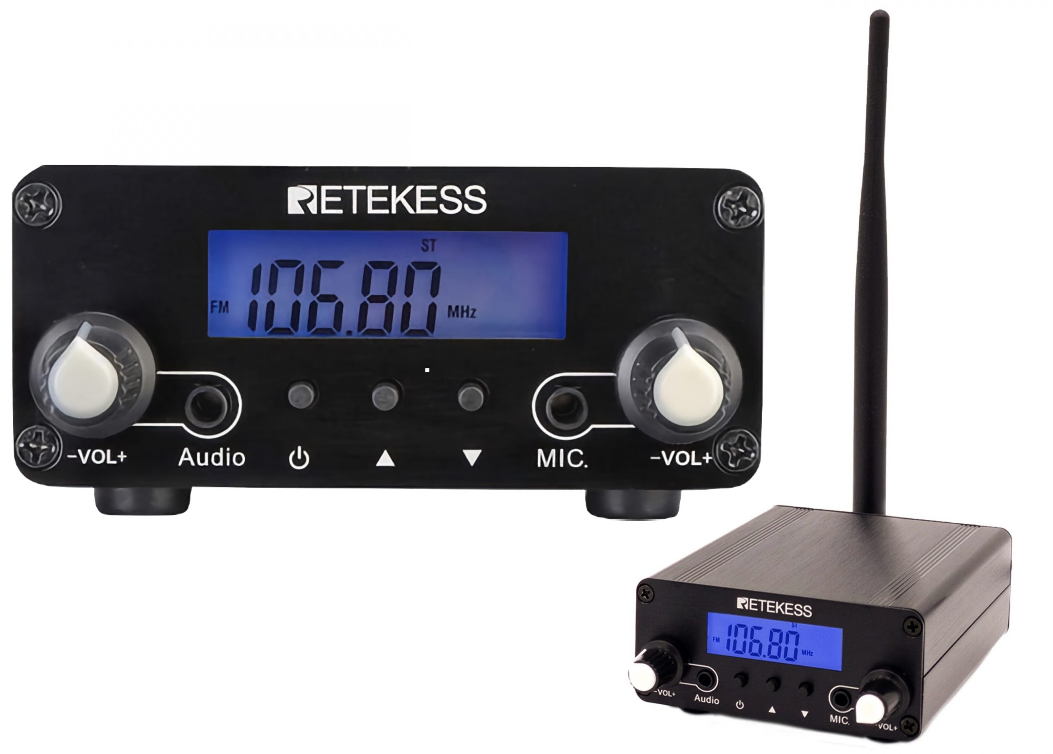
FM Transmitter
Sending audio to the next door (Frequency 87.5)

Slide 29
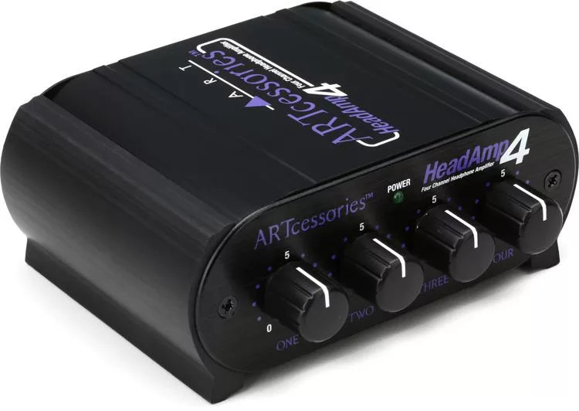
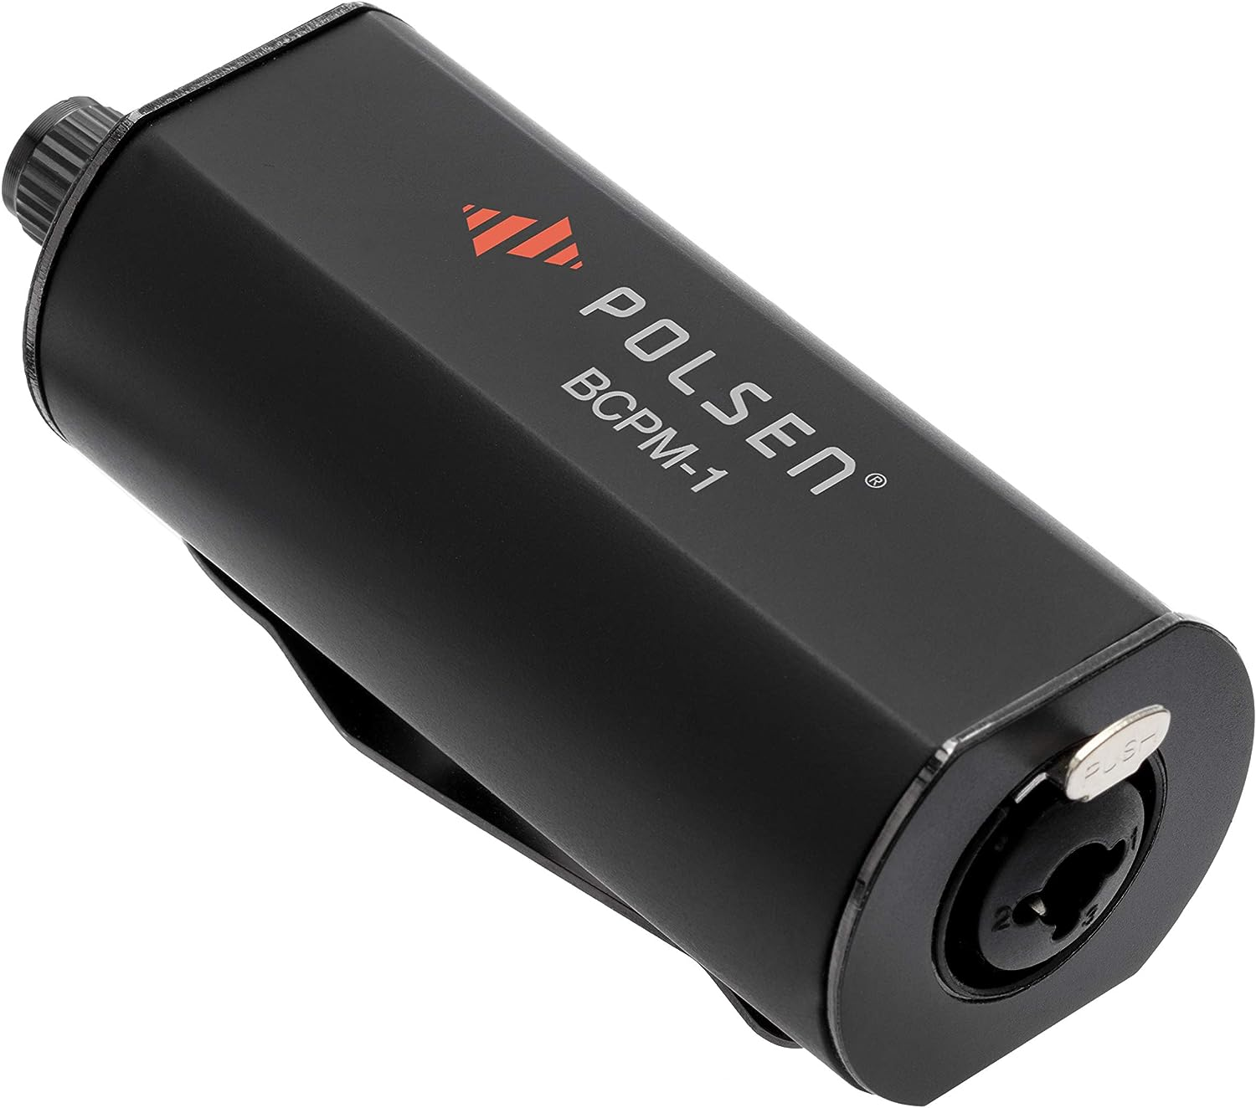
Headphone Amplifier
Our wired in-ear monitors (1 input, 4 outputs, Piano side)
Can work with the passive in-ear monitor below so that to allow musicians to adjust volume by themselves

Slide 30
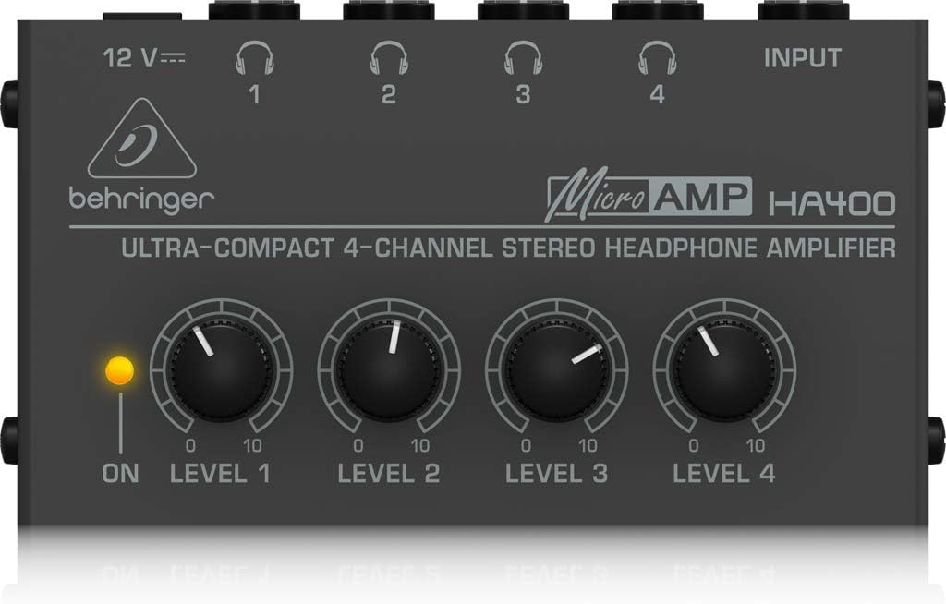
Behringer HA-400 Ultra Compact 4-Channel Stereo Headphone Amplifier
For wired in-ear monitors (Singer side)
Can work with the passive in-ear monitor below so that to allow musicians to adjust volume by themselves

Slide 31
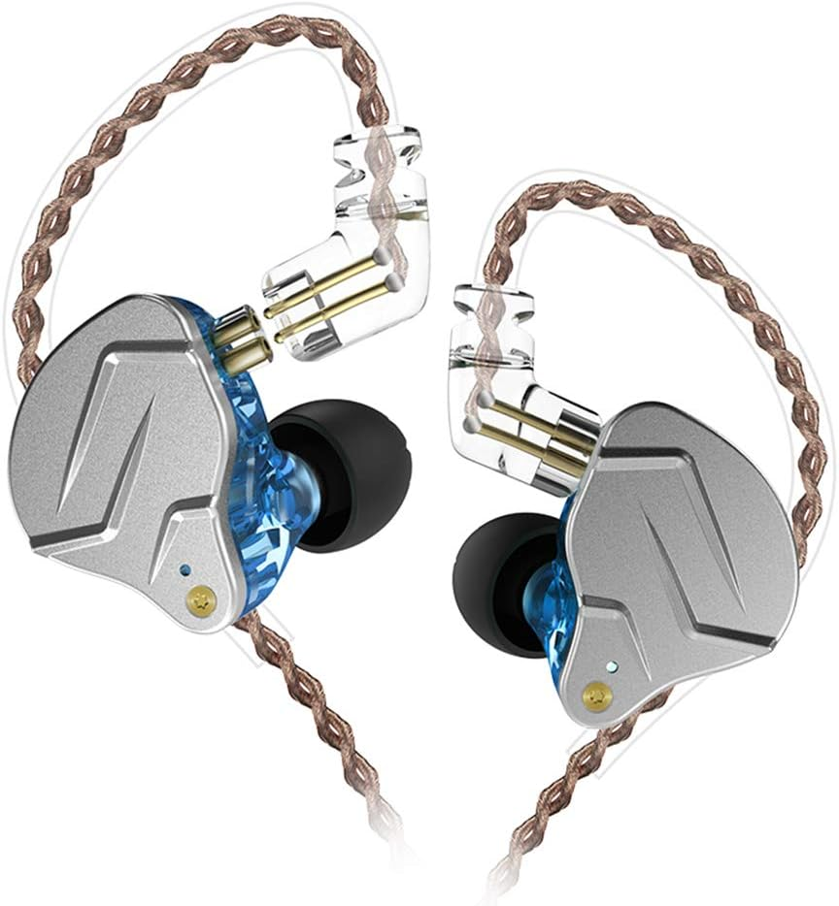
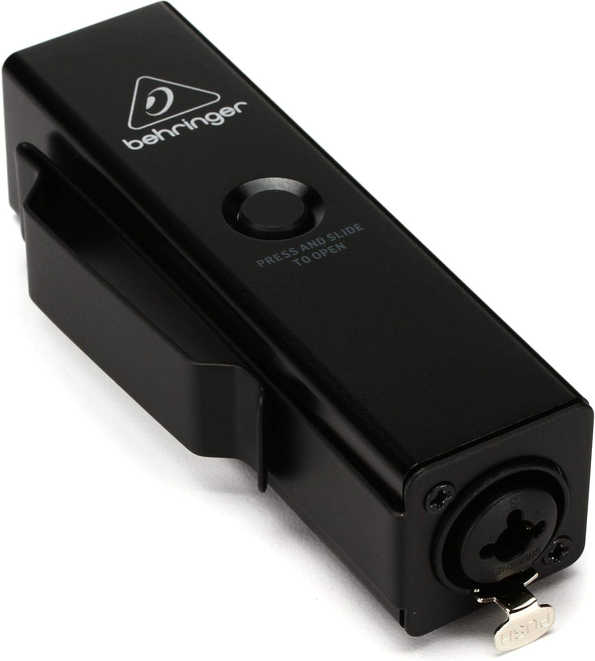
Active In-ear Monitors
Possible to customize a mix out for each channel
YINYOO KZ ZSN PRO in-Ear Headphones HiFi Noise-isolating in Ear Monitor
Behringer P2 Ultra-Compact Personal In-Ear Monitor Amplifier (Battery-powered)

Slide 32
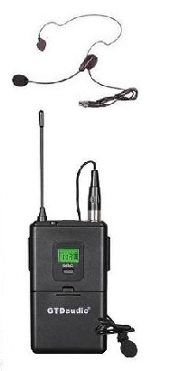
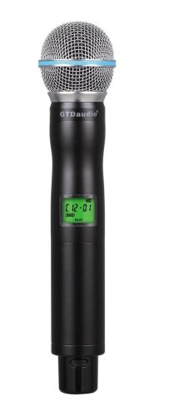
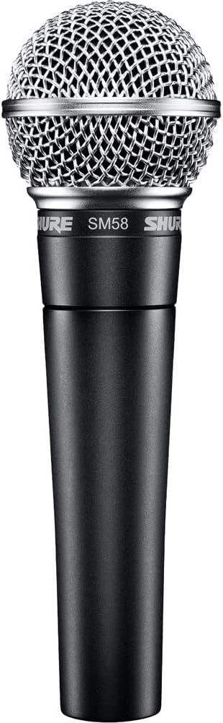
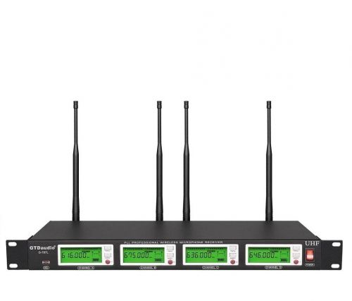
Our Microphones
GTD Audio G-787
Shure SM58

Slide 33
X32 Rack Hook-up
OUT 1-2 not in use
OUT 3-4 >> FM transmitter >> the next-door FM receiver and speakers
OUT 5-6 >> Sound Blaster K3+ audio interface >> computer for OBS streaming
OUT 7-8 >> power amp (NX300) Channel A-B >> two wall-mounted speakers
Aux OUT 1-6 not in use
Aux OUT 5-6
IN 1-2 Computer audio in
IN 3-4 HDMI audio in
IN 5-8 not in use
IN 9–12 << wireless microphone receiver
IN 13-16 not in use
Aux IN 1-6 not in use
USB 2.0 port <> the computer for live streaming and playback but we don’t use it (see slide 50)
Ethernet port <> (can add Router here) <> the computer for mixer control console
AC input << power conditioner
“FW 400” port – not in use
MIDI in/out– not in use
UltraNet– not in use
AES50 A – use CAT6E Cable connect to Behringer SD16 (next page)
AES50 B– not in use
Talkback/monitor - not in use

Slide 34
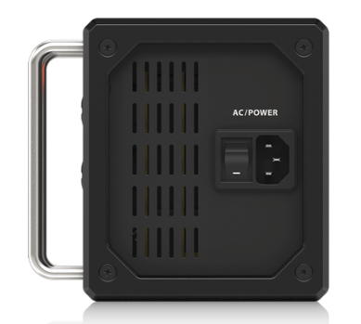
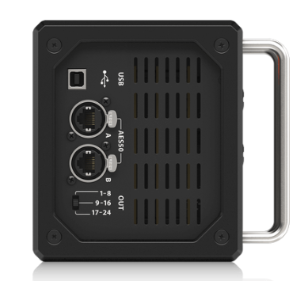
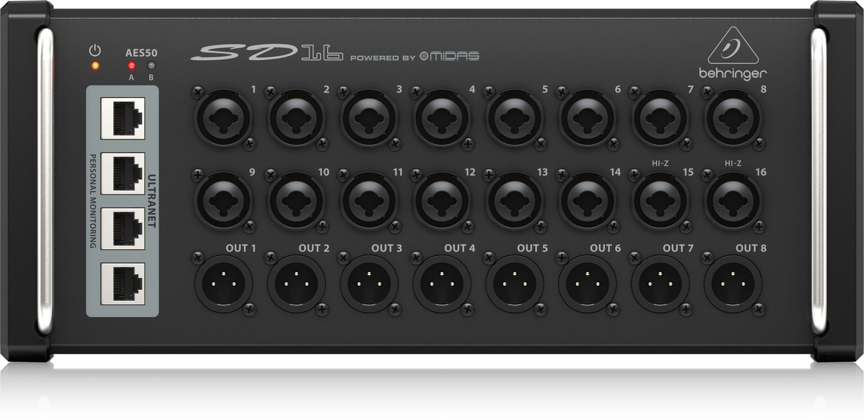
Behringer SD16 Hook-up
INPUT
  A 01-02 not in use
  A 03-04 << wired microphone (Vocal Mic k1 k2)
  A 05-06 << Keyboard (Keybd k1 k2)
  A 07-08 not in use
  A 09 << snake A << Guitar on the Right of the stage
  A 10-16 << snake B-J not in use
OUTPUT
  OUT 1 << X32 output 9 (Bus 3) >> Pianist 1 Monitor
  OUT 2 << X32 output 10 (Bus 4) >> Pianist 2 Monitor (battery powered Active In-ear Monitor)
  OUT 3-4 not in use
  OUT 5 << X32 output 13 (Bus 1) >> snake 1 >> Singer 1 monitor
  OUT 6 << X32 output 14 (Bus 2) >> snake 2 >> Singer 2 monitor (battery powered Active In-ear Monitor)
  OUT 7-8 >> snake 3-4 not in use
AC input << power extension cord on stage
USB not in use
AES50 A - use CAT6E Cable connect to X32
AES50 B not in use
OUT – switch set to 9-16

Slide 35
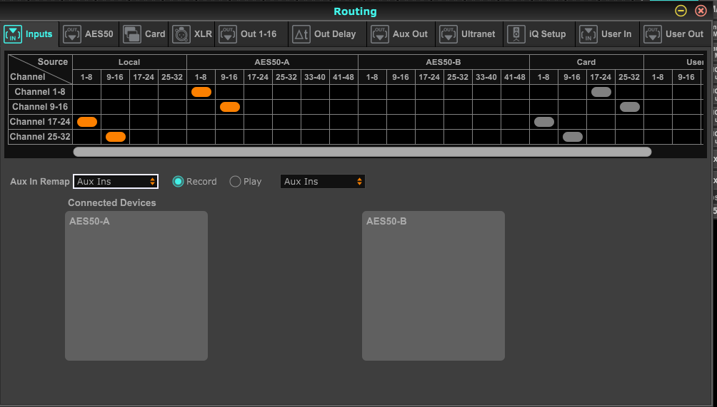
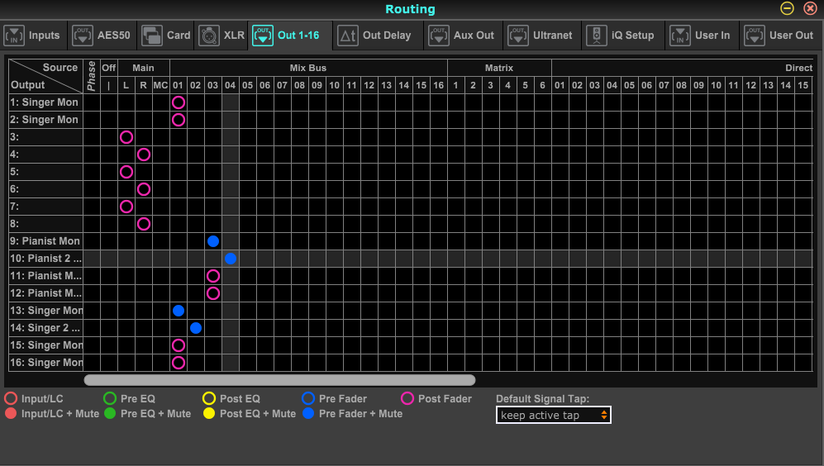
X32 Rack Signal Routing mapping/customizing the physical sockets with internal signals

Slide 36
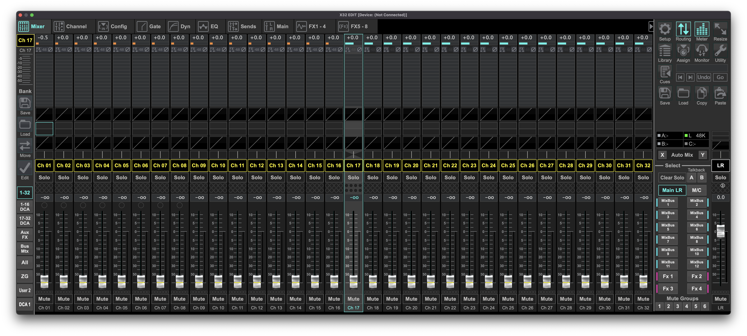
Routing Inputs mapping the physical(socket)/USB inputs to the channels on the control panel
Here are the ”AES50”
PC L and PC R in 01 02
Channels 1-8 <- AES50 1-8
  wired microphones and instruments on stage
Channels 9-16 <- AES50 9-16
  Right of the stage through snake. Channel 9 used for Guitar
Channels 17-24
  Channels 17-18 <- Computer Audio in L and R
    the computer stereo will be fed to channels 17/18 (which should be linked)
  Channels 19-20 <- HDMI audio in
  Channels 21-24 <- Local IN 5-8 (Not in use)
Channels 25-32
  Channels 25-28 <- Local IN 9–12 (wireless microphones on the top of the audio rack)
  Channel 29-32 <- Local IN 13-16 (Not in use)
HDMI In 03 04
Local In 5-8, 9-16
This is the ”card, not used”

Slide 37
Routing Outputs mapping the signals inside the mixer to the physical output sockets/USB outputs
OUT 1-2 <- MixBus 1
  We reserve MixBus 1 for monitors
OUT 3-4 <- Main L&R to FM transmitter >> the next-door FM receiver and speakers
OUT 5-6 <- MAIN L&R to Sound Blaster K3+ audio interface >> computer for OBS streaming
OUT 7-8 <- MAIN L&R
  The factory default reserves OUT 7-8 for the stereo MAIN LR
OUT 9-10 (AES50 OUT 1-2) <- MixBus 3-4
  Pianist 1 -2 Monitor
OUT 11-12 (AES50 OUT 3-4) <- MixBus 3
  Not in use
OUT 13-14 (AES50 OUT 5-6) <- Snake 1 -2 <- MixBus 1-2
  Singer 1 -2 Monitor
OUT 15-16 (AES50 OUT 7-8) <- Snake 3 -4 <- MixBus 1
  Not in use

Slide 38
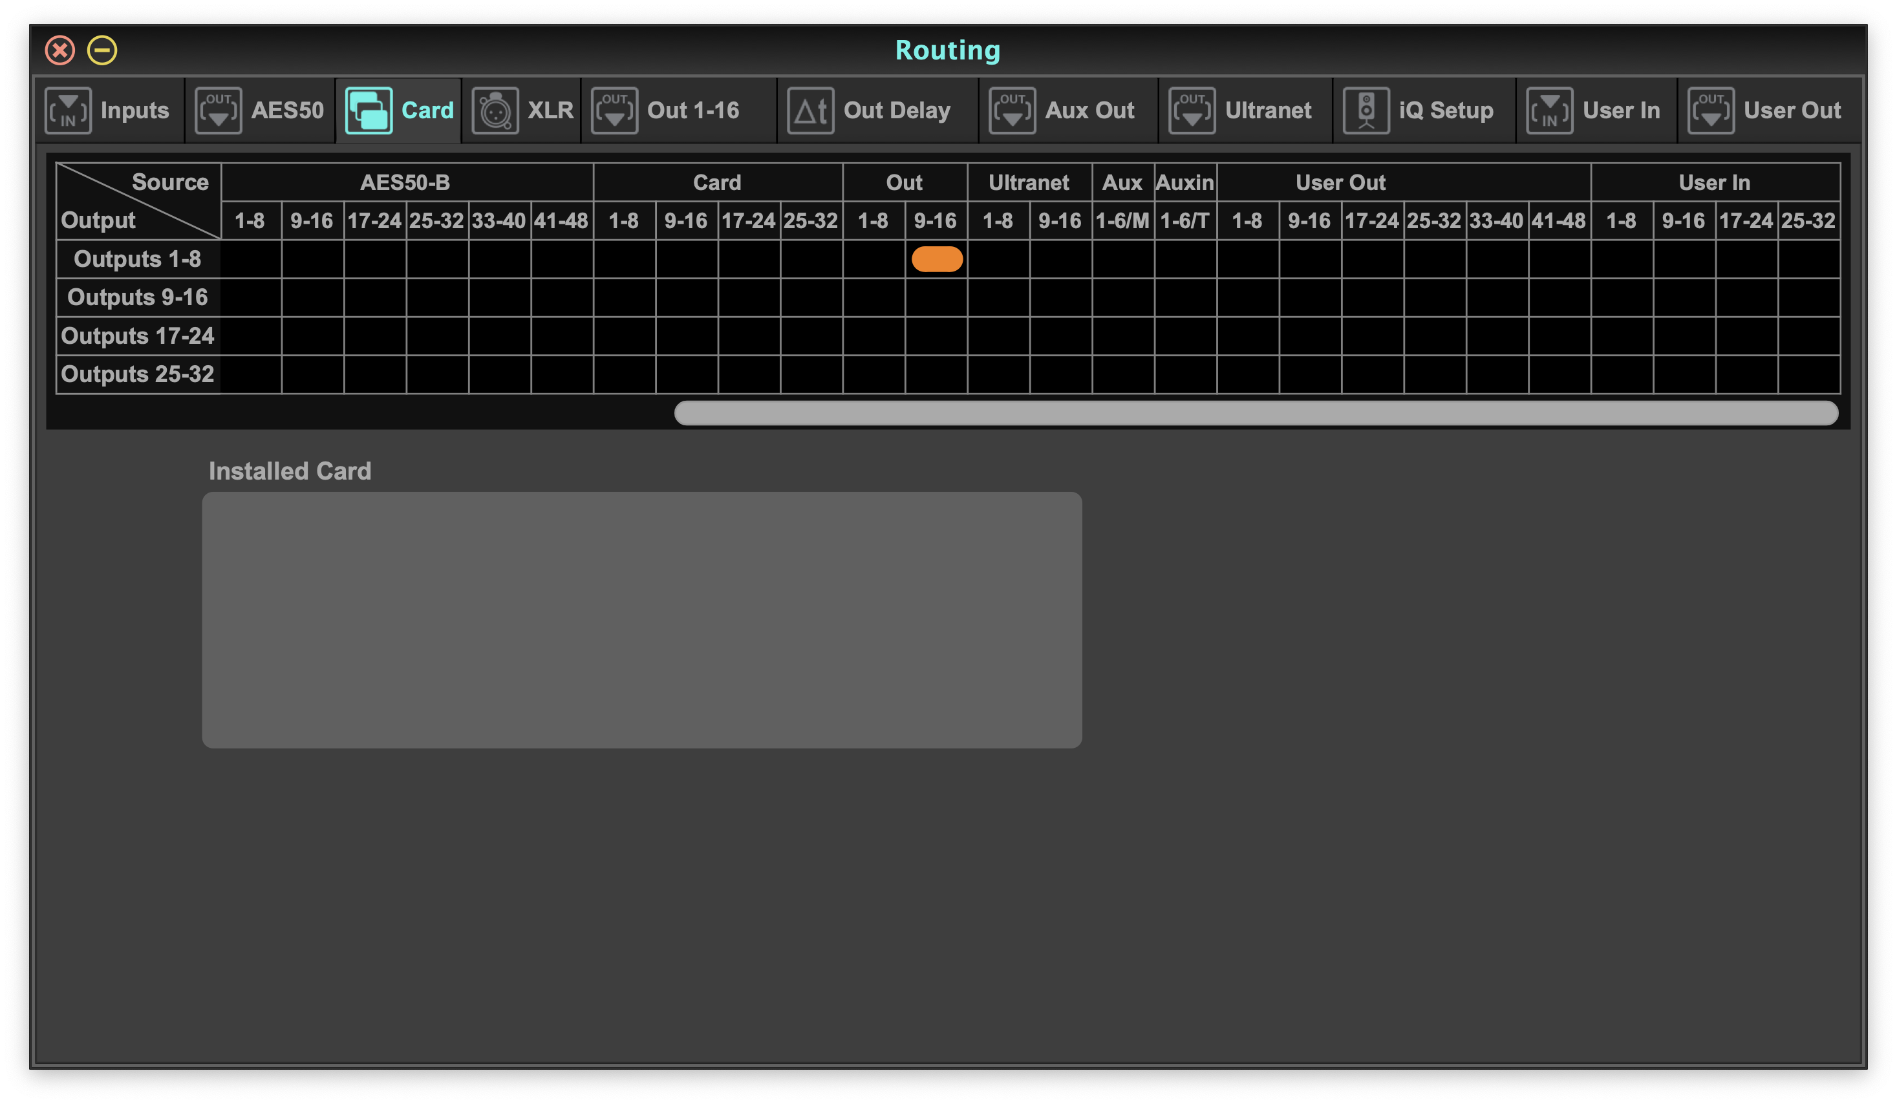
Routing Main LR (Pre-Fader+Mute)for Live Streaming
(Not In Use. Not updated)
We made a copy of MAIN LR (Pre-Fader + Mute) to OUT 9-10
Then we send/map OUT 9-10 to Card Outputs 1-8
On the computer, the copy of MAIN LR (Pre-Fader + Mute) will appear as “X-USB 1-2”
Therefore, we should feed “X-USB 1-2” to the streaming app ”OBS” as the “mic/aux in” (adjust the gain if necessary)

Slide 39
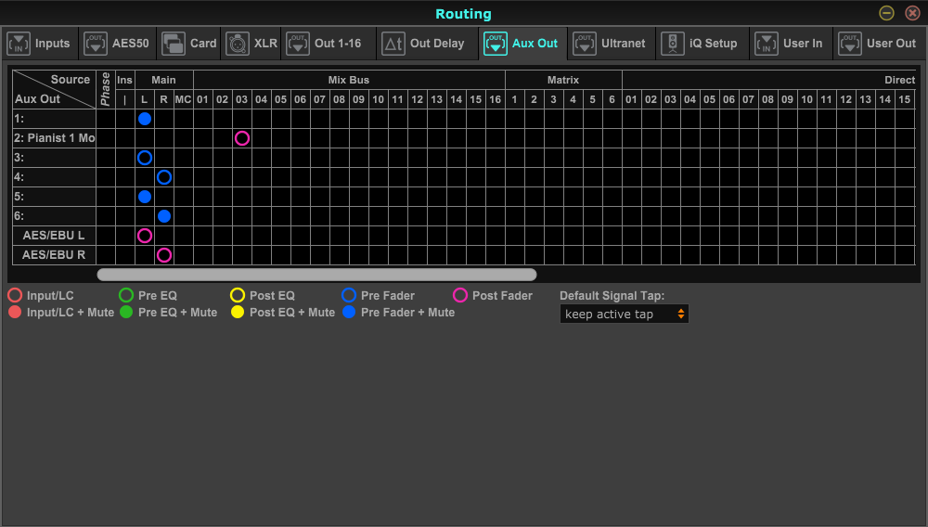
Routing Main LR (Pre-Fader) Of Aux Out
(Not In Use. Not updated)
Send Main L to Aux 1 to FM transmitter >> the next-door FM receiver and speakers
Send Main LR to Aux Out 5-6 to utilize the TRS/RCA sockets to Sound Blaster K3+ audio interface >> computer for OBS streaming
Aux Out 2-4 not in use

Slide 40
Power ON/OFF
Please follow the order below to turn ON the system:
  Power conditioner >> X32 rack >> power amplifier
Please follow the order below to turn OFF the system:
  Power amplifier >> X32 rack >> power conditioner

Slide 41
Our PA System: user’s manual
How to connect X32 rack to computers and/or iPad
How to use the on-board control panel on X32 rack
How to set gain for microphones and other instruments
How to send signals to a MixBus, e.g., Main LR, monitors
How to use Fx (effects), e.g., reverb
How to use the mute groups
How to set Low Cut/Gate/Dyn/EQ
How to link channels (for stereo inputs)
How to save/load settings
How to set the limiters on the power amplifier
How to set up and use the monitors
How to set up audio for live streaming on computer
How to playback audio through the built-in sound card
How to do multitrack recording
Service routine check list
Trouble shooting

Slide 42
How to tune the power amplifier Behringer NX3000 (once and for all)
The speakers and power amplifier much way more powerful than we may need (for some historical reason, we re-used the speakers). Therefore, we need to limit the output of the power amplifier.
The power amplifier just needs to be tuned once, and we should keep the settings unchanged, and fine the volume on the mixer. Below are how to initialize the settings:
  Before the procedure, make sure that the power amp is off and tune the level knobs to minimum;
  have a reference sound output from the mixer, make sure the averaged the output level around -18 dB. When observing the main out meter on the mixer panel, it should turn yellow from green frequently;
  Inject the output above to the power amp through Channel A and B;
  turn on the power amp, tune the level knobs up slowly, one click at a time. Listen to the main (loud) speakers, stop tuning up when it is loud enough.
  Keep the settings unchanged, fine tune the volume on mixer when needs.

Slide 43
Video System – Hardware
Dell desktop PC
Epson ceiling-mount projector
Sony camera
HDMI switch and splitter (2 in 4 out)
HDMI extension
HDMI capture cards x2

Slide 44
Video System – Signal Flow
Laptop for sermon
(the front computer)
HDMI switch/splitter
HDMI extension box
HDMI extension box
Switch between the two inputs
HDMI cable
ethernet cable
HDMI cable
Dell desktop PC
(the console)
HDMI cable
Duplicated signals thru HDMI cables
Over ceiling
USB cable
USB cable
Wall-mount 55-inch TV
Epson projector
HDMI capture card
HDMI capture card
HDMI cable
Sony camera

Slide 45
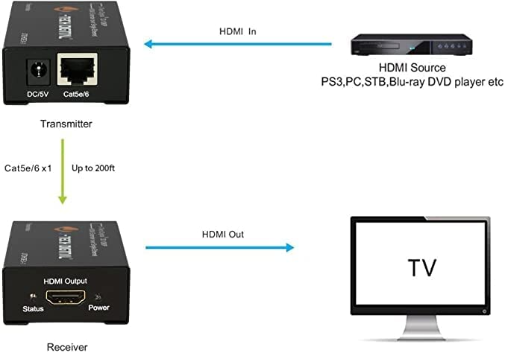
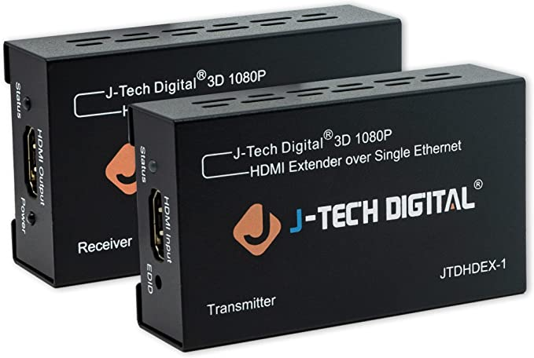
HDMI Extension
Deliver video/audio from front to console
Note: the limit length of HDMI cables ~ 50 ft

Slide 46
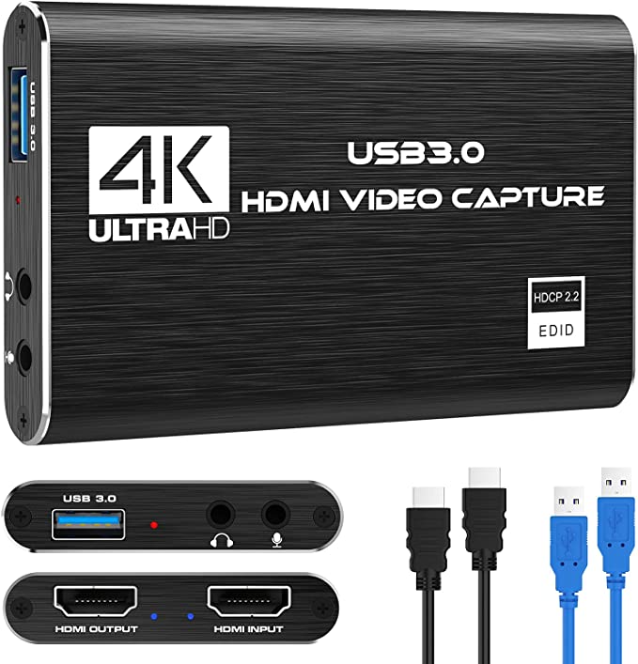
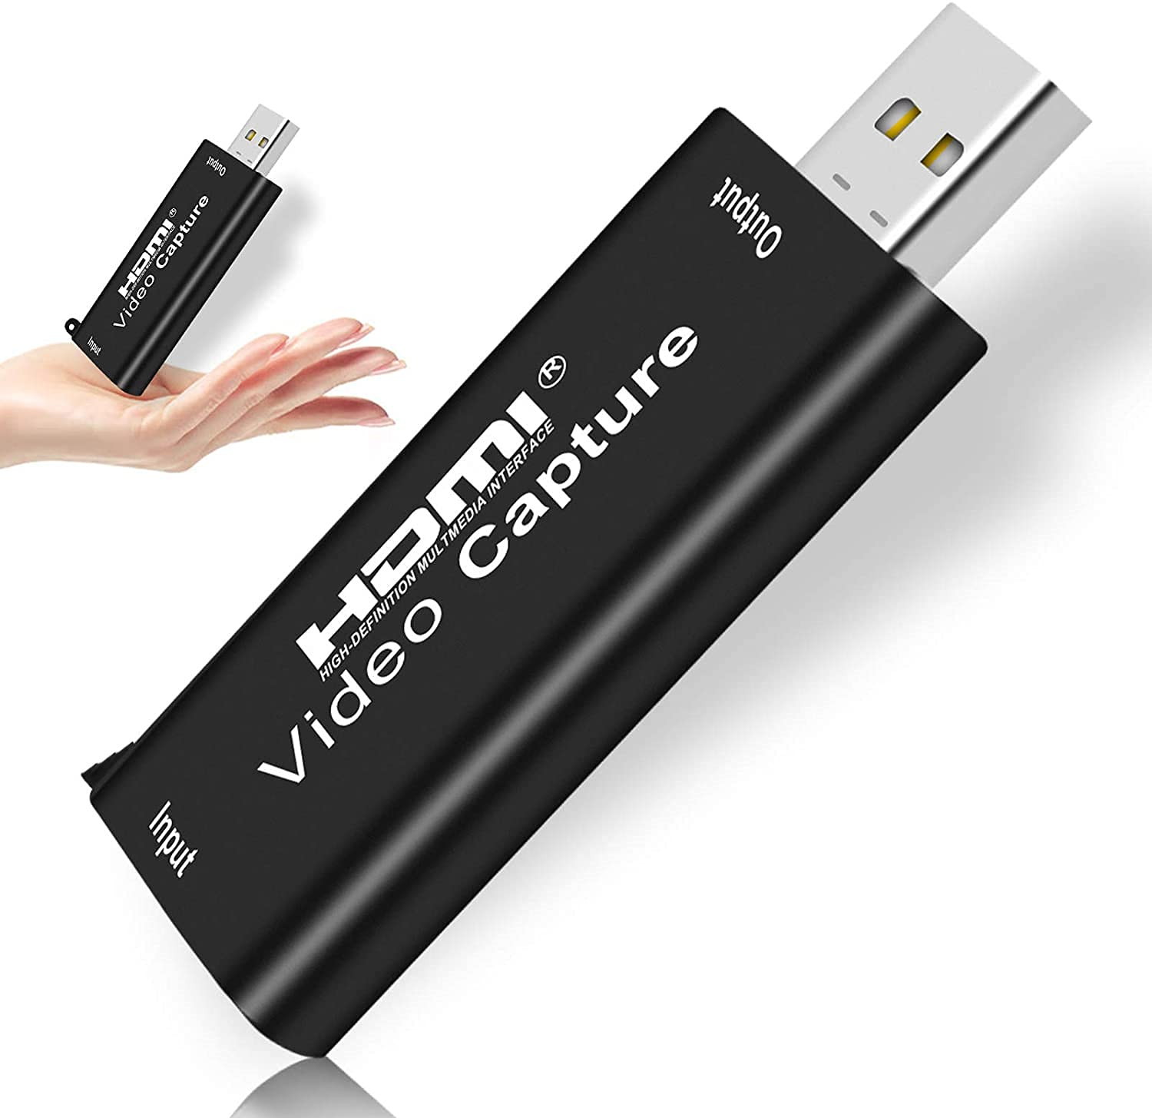
HDMI Capture Card
For capturing the projector screen
For the live-streaming camera

Slide 47
OBS as HDMI Switch?
It would work, but put too much stress on the console computer!
That is why we need a hardware solution for HDMI switching.

Slide 48
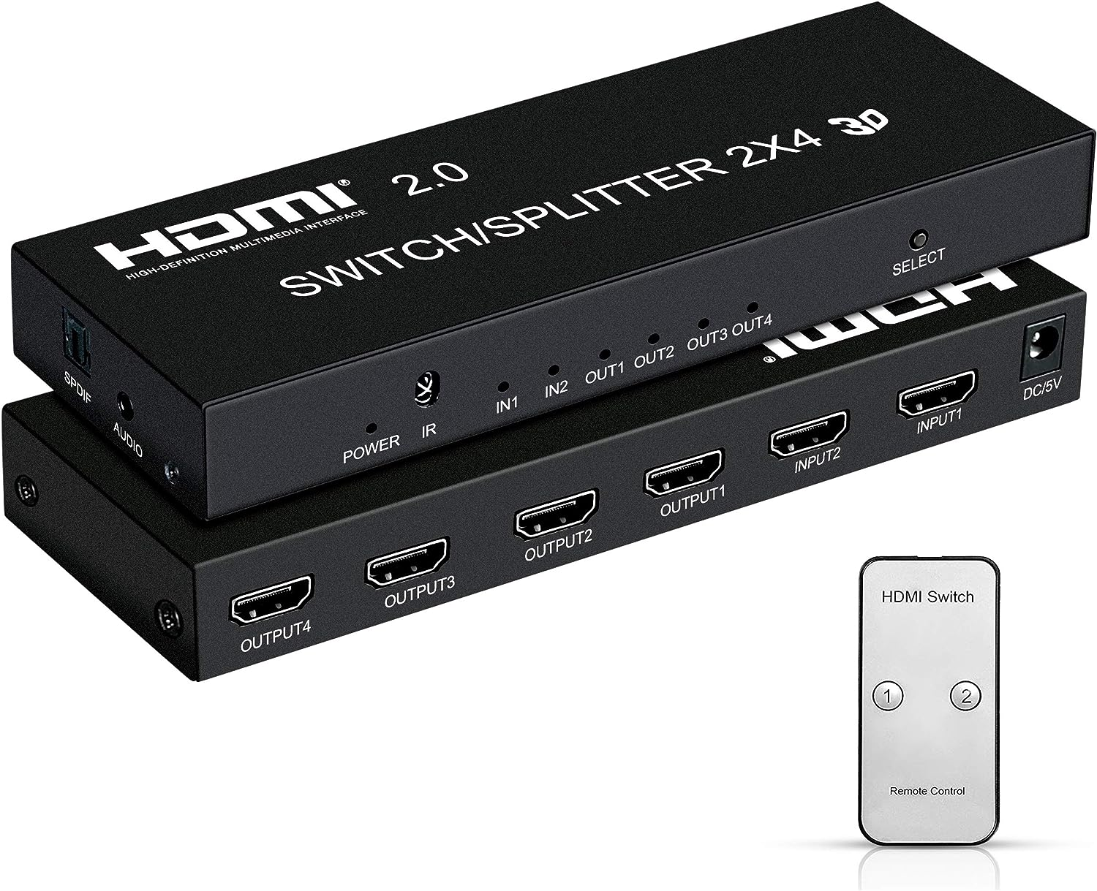
HDMI Switch and Splitter
The Heart of our video distribution system
Note that a single HDMI output could draw up to 300 mA at 5 V. We have 3 outputs from the box, so I recommend that the capacity of the power adopter should be > 2000 mA at 5 V.
We also extract audio from HDMI using this device and feed it to the mixer through the RCA aux input ports.

Slide 49
Sending computer audio to PA system?
There are two options
  Through the HDMI switch/splitter, the audio can be extracted from HDMI and fed to the mixer via the RCA aux input ports. This method applies to both the console computer and the front laptop for sermon;
  Through the built-in audio interface onboard the X32 mixer. By default, the stereo audio should be sent through the “X-USB out-1/2” channels. This method applies only to the console computer.

Slide 50
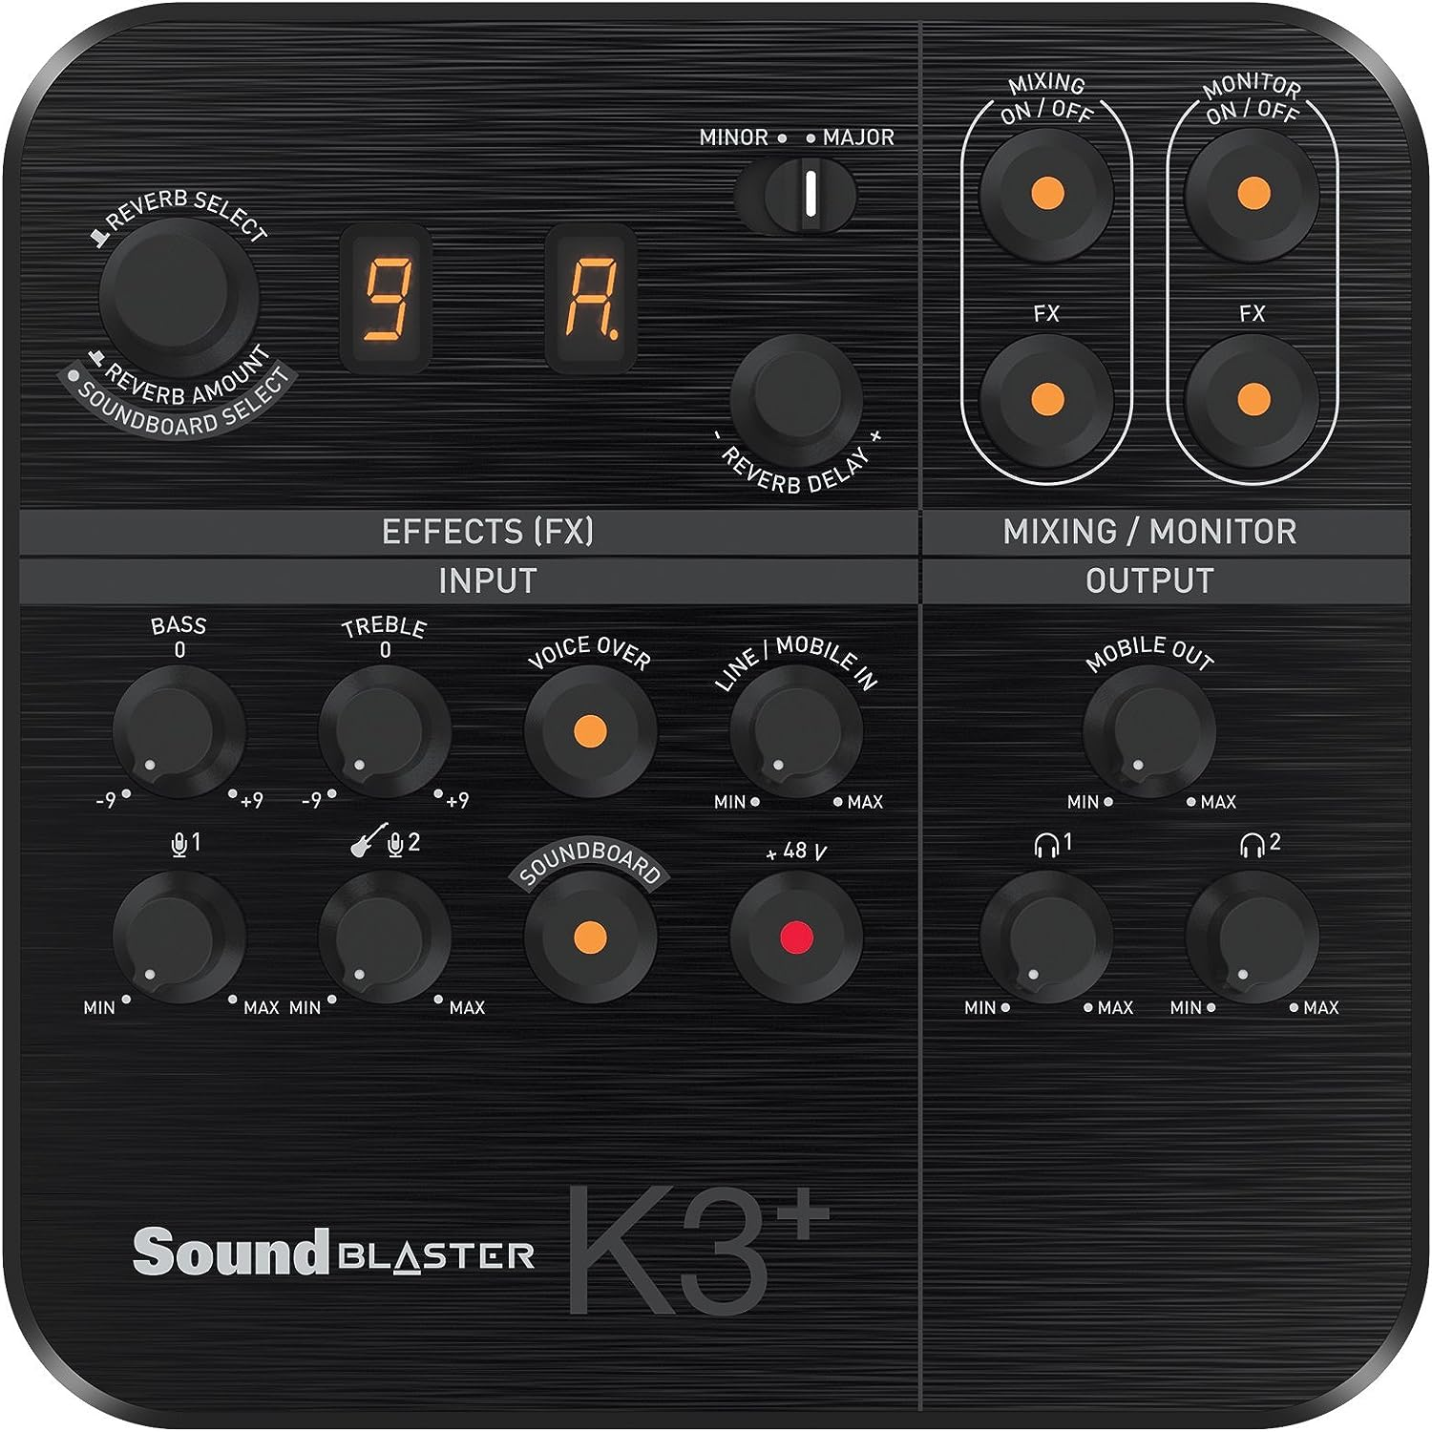
Audio Interface
Mixer output for live streaming
Why not using the built-in audio interface onboard the X32 mixer?
Theoretically, the X32 build-in audio interface is bi-directional, which means it should work for transferring the audio from the mixer to the PC (for live streaming).
But …
Practically, the audio interface is not stable, there are intermittent dropouts, which makes it unusable.
Sound Blaster K3+

Slide 51
Questions?
Comments?
Suggestions?

Slide 52
Thank you for your contribution!
Please email me if you have any questions ganzhaoming@gmail.com

